Slide 1
Computer Vision Fundamentals
Lecture 1 - Part 2
Knowing more about Images

Slide 2
Contents
What is an image?
Types of images?
Analog vs. Digital Image Processing
Key Concepts
Common image formats
Image File Types

Slide 3
What is an Image?
Every scene around us involves images or image processing
An image can be defined as a two dimensional signal (analog or digital) that contains intensity or color information arranged along x and y spatial axes
It can be defined as a two dimensional function f(x,y) where x and y are the spatial coordinates.
Here the amplitude of the function “f” at any pair of coordinates (x,y) is called intensity or grey level or the color of the image at that point
So, an image can be a collection of various amplitude functions arranged in a grid matrix to create an image of all pixels, each pixel having a distinctive amplitude function .

Slide 4
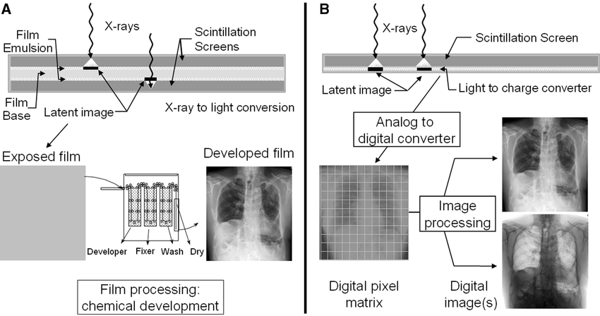
Types of Images
Images can be analog (A) or digital (B)

Slide 5
Analog v Digital Image processing
Analog Image Processing | Digital Image Processing
The analog image processing is applied on analog signals and it processes only two-dimensional signals. | The digital image processing is applied to digital signals that work on analyzing and manipulating the images.
Analog signal is time-varying signals so the images formed under analog image processing get varied. | It improves the digital quality of the image and intensity distribution is perfect in it.
Analog image processing is a slower and costlier process. | Digital image processing is a cheaper and fast image storage and retrieval process.
Analog signal is a real-world but not good quality of images. | It uses good image compression techniques that reduce the amount of data required and produce good quality of images
It is generally continuous and not broken into tiny components. | It uses an image segmentation technique which is used to detect discontinuity which occurs due to a broken connection path.

Slide 6
Key Concepts
Signal
A signal is a mathematical and statistical approach that relates us to the physical world. It can be measured through its dimensions and time over space. Signals are used to convey information from one source to another. Here, one-dimensional signals are measured on time over space and two-dimensional signals are measured on some other physical quantities, for example, digital image.
Relationship
A signal is that which conveys information around us in the physical world, it can be any voice, images etc. whatever we speak, it first converted into a signal or wave and then transfer to others in due time period. While capturing an image in the digital camera, a signal is transferred from one system to another.

Slide 7
Cont…
Machine or Computer Vision
Machine and computer vision are almost the same with a few other characteristics. It deals with developing a system in which input is an image and output is some information.
Computer graphics
Computer graphics is a series of an image which is formed from object models. Instead of capturing images from a device, images are generated using an object model. Computer generated images are used for making video games, movies, advertisement, etc.

Slide 8
Cont…
Artificial intelligence
Artificial Intelligence (AI) is an area of Computer Science that creates machine?s work and reacts like humans. Computer scenes are used after the image has been processed to obtain features. Artificial intelligence has many applications in image processing.
For example: X-ray, MRI, CT-Scan, etc. are in the form of the image which helps the doctor in treatment.
Signal processing
Signal processing includes extracting, manipulating, and storing information that has complex signals and images. There are many applications of signals in image processing.
For Example: In the field of medicine, there are both one and multidimensional signals such as EEG, ultrasound signals, etc. and 2 and 3-dimensional images such as ultrasound images, holographic images, etc.

Slide 9
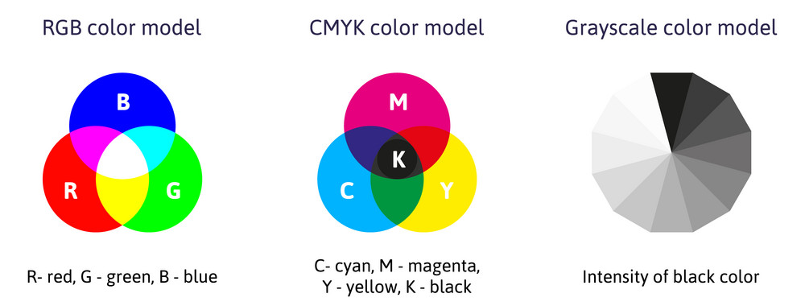
Common Image formats
Can be differentiated among three formats
1 sample (amplitude function) per point (B&W and grayscale)
3 samples per point (RGB)
4 samples per point (CMYK, RGBa)

Slide 10
Image File types
TIFF (.tif, .tiff): TIFF or Tagged Image File Format are lossless images files meaning that they do not need to compress or lose any image quality or information (although there are options for compression), allowing for very high-quality images but also larger file sizes.
Bitmap (.bmp): BMP or Bitmap Image File is a format developed by Microsoft for Windows. There is no compression or information loss with BMP files which allow images to have very high quality, but also very large file sizes. Due to BMP being a proprietary format, it is generally recommended to use TIFF files.
JPEG (.jpg, .jpeg): JPEG, which stands for Joint Photographic Experts Groups is a “lossy” format meaning that the image is compressed to make a smaller file. The compression does create a loss in quality but this loss is generally not noticeable. JPEG files are very common on the Internet and JPEG is a popular format for digital cameras - making it ideal for web use and non-professional prints.
GIF (.gif): GIF or Graphics Interchange Format files are widely used for web graphics, because they are limited to only 256 colors, can allow for transparency, and can be animated. GIF files are typically small is size and are very portable.
PNG (.png): PNG or Portable Network Graphics files are a lossless image format originally designed to improve upon and replace the gif format. PNG files are able to handle up to 16 million colors, unlike the 256 colors supported by GIF.

Slide 11
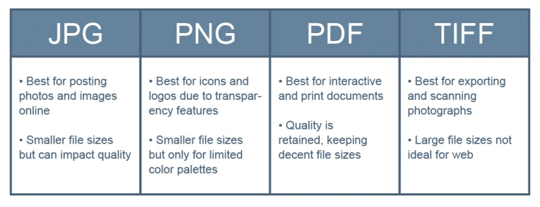
When to use what?

Slide 12
Thankyou

